Slide 1

The Art of the Upgrade
Based on a True Story
Notes:
There’s an art to arrive at an upgraded site first class, without unnecessary repetition of work. I would like to review here the lessons I learned from upgrading Sitecore. I won’t discuss the advantages of Sitecore 8, I will focus on the upgrade process itself.

Slide 2

Mark Saad
Sitecore Developer @ Velir
Mark.Saad@velir.com
Twitter @MarkAdel1
Blog @ marksaad.net

Slide 3

The Traditional Approach
Notes:
This was my first Sitecore upgrade, we had a site on Sitecore 6.5 we wanted to upgrade to Sitecore 8. Reading through the documentation and other materials online, it seemed like I have a road trip ahead of me. I need to make a stop at each point Sitecore released.

Slide 4
The Road Trip
6.5
7.0
7.1
6.6
7.2
7.5
8.0
8.0.3
Notes:
In my particular case, It means that I will go from 6.5 to 6.6, 7.0, 7.1, 7.2, 7.5, 8.0 then 8.0 update-3. so my road trip map would be something like this. But to get from one stop to the next, you have to go through these seemingly simple steps:

Slide 5
The Road Trip
6.5
7.0
7.1
6.6
7.2
7.5
8.0
8.0.3
1. Branch
2. Run the upgrade wizard
3. Configuration Changes
4. Code changes
Notes:
You need a new branch for each point upgrade, and I will get to why that’s necessary for each point upgrade. Then you run the upgrade wizard, do the configuration changes and some code changes, make sure that the solution builds at least so that you can run the upgrade wizard next time, make sure to commit everything.

Slide 6
The Road Trip
6.5
7.0
7.1
6.6
7.2
7.5
8.0
8.0.3
1. Branch
2. Run the upgrade wizard
3. Configuration Changes
4. Code changes
1. Branch
2. Run the upgrade wizard
3. Configuration Changes
4. Code changes
Notes:
Repeat

Slide 7
The Road Trip
6.5
7.0
7.1
6.6
7.2
7.5
8.0
8.0.3
1. Branch
2. Run the upgrade wizard
3. Configuration Changes
4. Code changes
1. Branch
2. Run the upgrade wizard
3. Configuration Changes
4. Code changes
1. Branch
2. Run the upgrade wizard
3. Configuration Changes
4. Code changes
Notes:
Repeat

Slide 8
The Road Trip
6.5
7.0
7.1
6.6
7.2
7.5
8.0
8.0.3
1. Branch
2. Run the upgrade wizard
3. Configuration Changes
4. Code changes
1. Branch
2. Run the upgrade wizard
3. Configuration Changes
4. Code changes
1. Branch
2. Run the upgrade wizard
3. Configuration Changes
4. Code changes
1. Branch
2. Run the upgrade wizard
3. Configuration Changes
4. Code changes
Notes:
Repeat

Slide 9
The Road Trip
6.5
7.0
7.1
6.6
7.2
7.5
8.0
8.0.3
1. Branch
2. Run the upgrade wizard
3. Configuration Changes
4. Code changes
1. Branch
2. Run the upgrade wizard
3. Configuration Changes
4. Code changes
1. Branch
2. Run the upgrade wizard
3. Configuration Changes
4. Code changes
1. Branch
2. Run the upgrade wizard
3. Configuration Changes
4. Code changes
1. Branch
2. Run the upgrade wizard
3. Configuration Changes
4. Code changes
Notes:
Repeat

Slide 10
The Road Trip
6.5
7.0
7.1
6.6
7.2
7.5
8.0
8.0.3
1. Branch
2. Run the upgrade wizard
3. Configuration Changes
4. Code changes
1. Branch
2. Run the upgrade wizard
3. Configuration Changes
4. Code changes
1. Branch
2. Run the upgrade wizard
3. Configuration Changes
4. Code changes
1. Branch
2. Run the upgrade wizard
3. Configuration Changes
4. Code changes
1. Branch
2. Run the upgrade wizard
3. Configuration Changes
4. Code changes
1. Branch
2. Run the upgrade wizard
3. Configuration Changes
4. Code changes
Notes:
Repeat

Slide 11
The Road Trip
6.5
7.0
7.1
6.6
7.2
7.5
8.0
8.0.3
1. Branch
2. Run the upgrade wizard
3. Configuration Changes
4. Code changes
1. Branch
2. Run the upgrade wizard
3. Configuration Changes
4. Code changes
1. Branch
2. Run the upgrade wizard
3. Configuration Changes
4. Code changes
1. Branch
2. Run the upgrade wizard
3. Configuration Changes
4. Code changes
1. Branch
2. Run the upgrade wizard
3. Configuration Changes
4. Code changes
1. Branch
2. Run the upgrade wizard
3. Configuration Changes
4. Code changes
1. Branch
2. Run the upgrade wizard
3. Configuration Changes
4. Code changes
Notes:
Ok,, so that’s the final road trip map, pretty! Isn’t it? Imagine yourself doing this during a production deployment, make sure everything goes as it should! If you use a branch for each point during the deployment, you only deploy that branch, run the upgrade wizard and do any manual changes required and repeat… I won’t add that to my slides, there’s no more room!

Slide 12

The Unhappy Trip
Notes:
I think it’s easy to see why it was an unhappy trip. You probably can manage to arrive, eventually. This isn’t the kind of trip that I would like

Slide 13

Slightly Better Trip…
Notes:
That’s the trip that I would like!

Slide 14
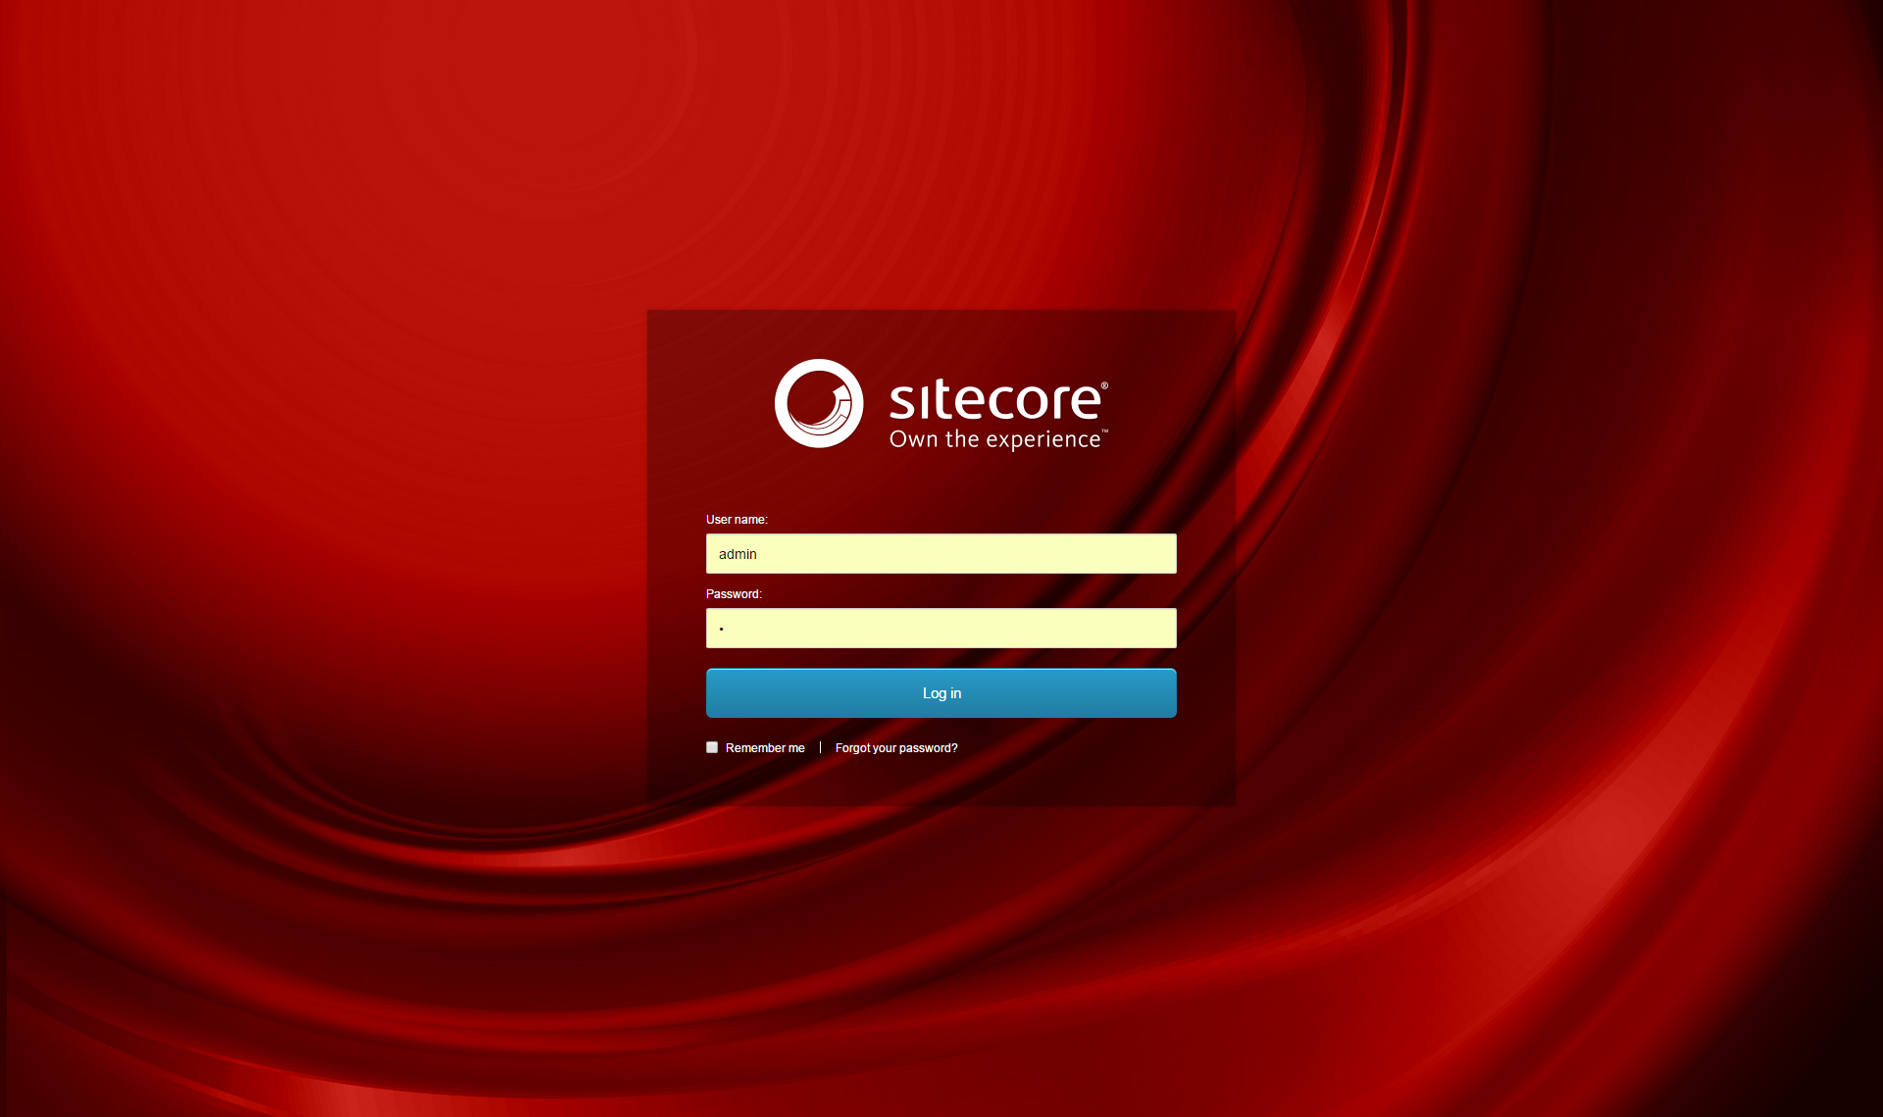
Better Approach
Start with Sitecore 8.0!
Notes:
I thought about it this way, each upgrade wizard runs some scripts on your database, adds some files, and then you need to do some configuration changes. And repeat!
A better approach to that would be to start with Sitecore 8, your target Sitecore version, migrate your content, migrate your custom configurations and fix your solution. That’s it! But there’s an art to do that efficiently.
All you need to start is Sitecore 8 zip and Sitecore Instance Manager, and then you have a working Sitecore 8 site that you can upgrade your current site to.

Slide 15
The Art of Sitecore Upgrade
Discovery
Notes:
We will talk about each of these steps through the rest of this presentation. Starting with a discovery phase helps you time-box the upgrade project and set the expectations with a realistic plan.

Slide 16
The Art of Sitecore Upgrade
Discovery
Content Migration
Notes:
This is how you move your old Sitecore content to the new Sitecore 8

Slide 17
The Art of Sitecore Upgrade
Discovery
Content Migration
Configuration changes migration
Notes:
Starting with a new Sitecore 8 doesn’t mean we will develop a new project from scratch, we will migrate our custom configurations without messing with Sitecore configurations

Slide 18
The Art of Sitecore Upgrade
Discovery
Content Migration
Configuration changes migration
Solution upgrade
Notes:
There’s also a process to upgrade the custom solution to work with the new Sitecore, a major part of that is search upgrade assuming you’re upgrading from Sitecore 6.
You can do it in this order or any other order that makes sense to you! I think starting with well thought discovery is what makes sense to most people.

Slide 19
The Art of Sitecore Upgrade
Discovery
Content Migration
Custom Configuration migration
Solution upgrade
Deployment
Notes:
We will also talk briefly about deployment steps

Slide 20
1. Discovery
Notes:
It is particularly important to start with a thorough discovery, Sitecore upgrades are not one size fits all and the most important output of the discovery here is to size the upgrade project. This will also help you assess the risks and set the expectations.

Slide 21
1. Discovery
Prerequisites
Notes:
Start your discovery by looking at the prerequisites for Sitecore 8, especially Mongo.

Slide 22
1. Discovery
Prerequisites
  MongoDB
Notes:
make sure that you’re ready to make the move to mongo or otherwise understand the limitations. Which are defined in a knowledge base article
https://kb.sitecore.net/articles/296641
If you have forms data that you need to migrate to Sitecore 8, there’s a conversion tool that would migrate the DMS and WFFM databases. If you just had WFFM but not DMS you can’t migrate the WFFM database, that’s regardless of how you do the upgrade. I reported that to Sitecore support and they registered it as a wish/feature request with reference number 432610, if you would like to track it.

Slide 23
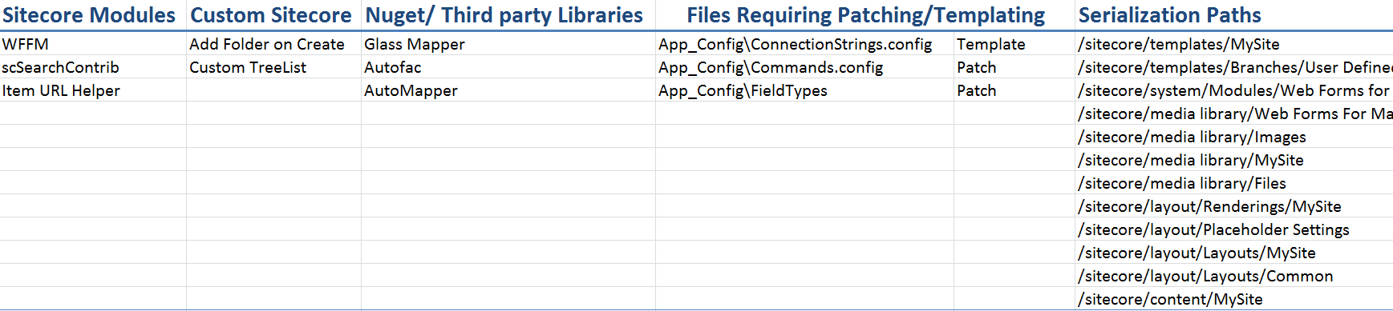
1. Discovery
Discovery Sheet
Notes:
Don’t try to read the sheet right now, it’s intentionally small.
After you’re done with the prerequisites, you need to gather more information about your current Sitecore to see what exactly you will need to upgrade. The best to place to gather this information from is Sitecore’s showconfig page. Then you will create some sheet similar to this one to summarize all your customizations.
You need a list of the current Sitecore modules, custom Sitecore, files that require patching or templating, and nuget packages or whatever third party libraries you’re using in your current solution as well as a list of the serialization paths. The effort to upgrade will largely depend on how big these lists are.

Slide 24
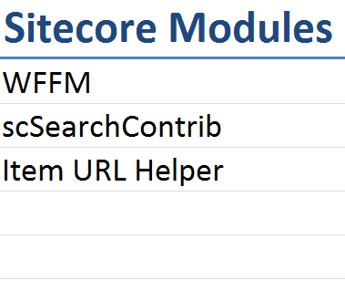
1. Discovery
Sitecore Modules
Notes:
For example, what modules will work with Sitecore 8 and what modules will you replace.

Slide 25
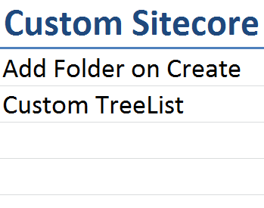
1. Discovery
Custom Sitecore
Notes:
You may have pipeline processors that you need to revisit or custom fields or others. These either inherit from a Sitecore class or just copy Sitecore code using reflection and make the changes o that copy. It’s important to have a list of these at the beginning and make a judgment call on which would stay and what do you have to do about that.

Slide 26
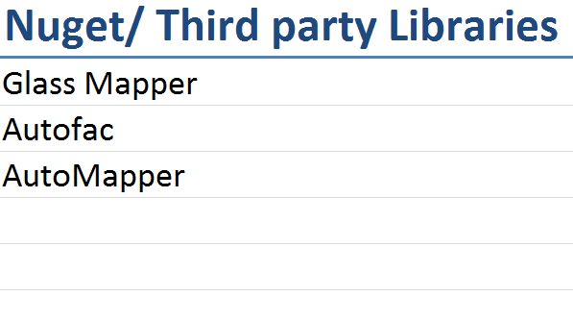
1. Discovery
Libraries
Notes:
Also, looking at this list you can see if some libraries can be upgraded and tested before even upgrading Sitecore or they are just nuget upgrades.

Slide 27
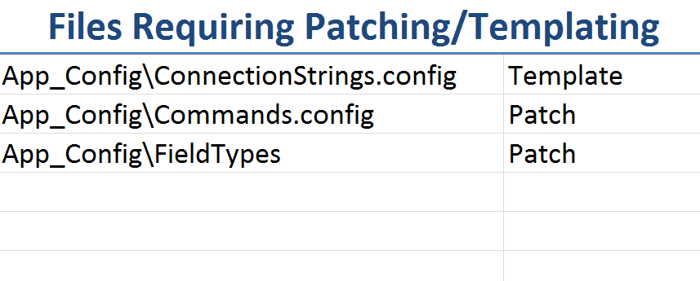
1. Discovery
Configuration Files
Notes:
We only care about the files different from vanilla Sitecore files. These files will either be patched or templated and it’s better to patch or template those files before the upgrade itself as I will describe later.

Slide 28
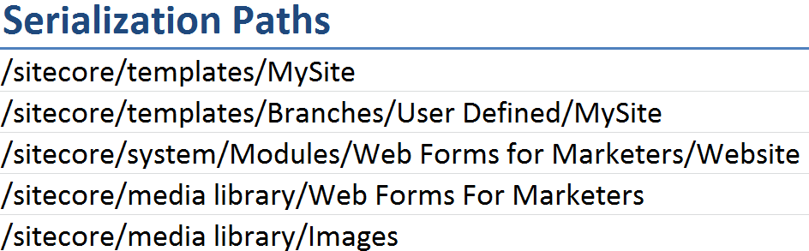
1. Discovery
Serialization Paths
Notes:
We will move to the content migration section next, but for now you need a list that has the parents of all the content items that aren’t Sitecore default.

Slide 29
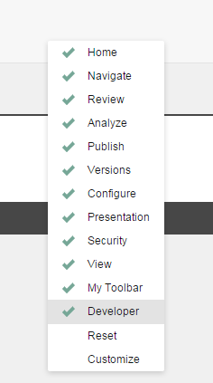
2. Content Migration
Serialization and Reverting
Notes:
To enable the Serialization ribbon, right click on any empty area in content editor ribbons, you will get this list, check the Developer toolbar.

Slide 30
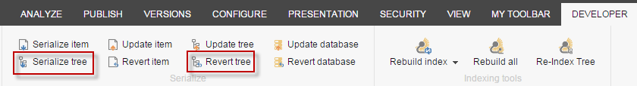
2. Content Migration
Serialization and Reverting
Notes:
In the developer toolbar there’s a serialize tree button and a revert tree button. On your old Sitecore, All you have to do is for each serialization path, you will serialize the tree, which serializes the item and subitems to text files, you then copy the serialization folder to your new Sitecore and click revert tree for the same paths. That will migrate all your content to the new Sitecore. Since the content for the new Sitecore is coming from the serialized text files and added through the revert tree, your content will go to the Sitecore 8 database as if it was created in that version.

Slide 31
2. Content Migration
Packages vs Serialization
Notes:
Another way of migrating content is using packages, packages have size limitations, and may have problems across different versions of Sitecore because of schema changes. I prefer serialization as it doesn’t have those size limitations and it’s easier to keep track of the paths that was serialized and revert them in the target Sitecore. You can also serialize roles, users and just about any content that was created in Sitecore. When you revert that content in the new Sitecore, it gets the new schema automatically and if you have your custom pipelines setup, it will run through those normally (if you need them to). You can also keep track of the differences between master and web databases by serializing and reverting both.

Slide 32
3. Configuration Migration
Patch Files
Notes:
So you have made the discovery, compared your old Sitecore configuration files to the vanilla files for that version, and you have a list of the configuration changes that you need for your site to work properly. Before proceeding any further, make sure that all your custom configurations are separated in clean patch files. I would do that on the old Sitecore and test that everything is still working the same way. This way whatever Sitecore configuration files you will get with the new update, your custom configurations will be separated. I move all the custom configuration files into a single folder under Include and test that everything still works as expected and showconfig.aspx isn’t changed. Git can ignore any files with .config outside that custom folder.

Slide 33
4. Solution Upgrade
Preparation
Notes:
In preparation for the solution upgrade, you need to install .net framework 4.5.2 if you haven’t already. Then, you can upgrade the solution by replacing the Sitecore DLLs references or what I prefer personally is to start a new project and only add items as necessary, this way you will have correct references with correct version numbers and will help you with the next point.

Slide 34
4. Solution Upgrade
Preparation
Sitecore Support Patches
Notes:
Sitecore upgrades come with a lot of bug fixes. Those bug fixes where previously Sitecore support DLLs referenced in the solution and the configuration files. You need to get an inventory of the support DLLs and compare them against the Sitecore release notes to exclude any DLL that corresponds to a bug that’s already fixed in your new version. Even if the bug wasn’t fixed in the release you’re upgrading to; chances are that the support DLL you’re using isn’t the correct one.

Slide 35
4. Solution Upgrade
Preparation
Sitecore Support Patches
Build Errors
Notes:
You will probably see some build errors in your solution and there are three major sources for the build errors:
1. Third party libraries incompatibility: these should be replaced with a compatible version.
2. Sitecore method calls: deprecated Sitecore calls have some guidance about how to replace them.
3. If you’re upgrading from Sitecore 6, your lucene search code will be broken.

Slide 36
4. Solution Upgrade
Preparation
Sitecore Support Patches
Build Errors
Custom Sitecore
Notes:
Most of these classes add business logic to the old Sitecore implementation; these have to be assessed on a case by case basis. If these classes were copying the Sitecore code of some private methods and modifying them, you need to see how that code has changed with the new version, this is one area I hope gets better with new Sitecore versions.

Slide 37
4. Solution Upgrade
Preparation
Sitecore Support Patches
Build Errors
Custom Sitecore
Search Upgrade
Notes:
This is a major part of the upgrade, with Sitecore 7+ a lot has changed with Search; the use of Sitecore.ContentSearch is the new standard. You can continue using lucene, or you can use a different “Search Provider” such as solr. The use of Sitecore.ContentSearch API hides most of the details of the search provider you will use and is very simple to use compared to anything you had to deal with before.

Slide 38
4. Solution Upgrade
Preparation
Sitecore Support Patches
Build Errors
Custom Sitecore
Search Upgrade
  Coveo
Notes:
Also if you were using Coveo that will need to be upgraded, I was able to use Sitecore Connector 2 to crawl Sitecore 8 but that’s not supported by Coveo. For more information: http://marksaad.net/2015/06/16/using-coveo-sitecore-connector-with-sitecore-8/

Slide 39
5. Deployment
Setup a new Sitecore 8 instance
Notes:
We do the upgrade side by side, meaning that you have a new Sitecore 8 instance on a production server beside the live one. All the deployment and build steps will be applied to the new instance and the live one won’t be touched except at the very end.

Slide 40
5. Deployment
Setup a new Sitecore 8 instance
Migrate the Content
Notes:
You will need to migrate the content once again, this time it’s live content. It’s better to do this during a content freeze window, which can be lengthy, I heard some great ideas to make this faster though. If content needs to be pushed out immediately for any reason, it can still be done in the old (live) instance and then migrated to the new one.

Slide 41
5. Deployment
Setup a new Sitecore 8 instance
Migrate the Content
Rebuild all indexes
Notes:
After migrating the content rebuild all the lucene/solr/coveo indexes

Slide 42
5. Deployment
Setup a new Sitecore 8 instance
Migrate the Content
Rebuild all indexes
Switch bindings
Notes:
If all goes well, then you can switch the live bindings to the new instance and you’re live!

Slide 43
Recap
Discovery is your best friend

Slide 44
Recap
Discovery is your best friend
Start with Sitecore 8

Slide 45
Recap
Discovery is your best friend
Start with Sitecore 8
Use Serialization

Slide 46
Recap
Discovery is your best friend
Start with Sitecore 8
Use Serialization
Use Patch Files

Slide 47
Recap
Discovery is your best friend
Start with Sitecore 8
Use Serialization
Use Patch Files
Refactor Search

Slide 48

The Art of the Upgrade
Mark.Saad@velir.com
Twitter @MarkAdel1
Blog @ marksaad.net

Slide 49
Thanks!

